Slide 1
Software Database Management System
Capstone Project – Review II
Database Implementation
Database Management Systems (2501IT05)
Team Members
S.ARAVINDA REDDY
AIML
25B11AIB48
M.GANGADHAR
AIML
25B11AI658
T.ESWAR VARDHAN
AIML
25B11AIB99
V.SATYA SAI
AIML
26B21AI151
K.V.SAI GANESH
AIML
25B11AI537
Under the guidance of
Dr. P. Kishorekumar, PhD.
Associate Professor, Department of AIML

Slide 2
1. Project Overview
• Software Database Management System is a database system for managing software development and project-related information.
• It stores client, project, employee, team, software product, requirement, issue, and project assignment details.
• It maintains relationships between different tables using Primary Keys and Foreign Keys.
• SQL is used to insert, update, delete, retrieve, and analyze data.
• Constraints are used to maintain data accuracy and integrity.
• The system reduces data duplication through normalization.
Main Modules :
Customer Management
Account Management
Branch Management
Employee Management
Transaction Management
Loan Management
2

Slide 3
2. Existing System and Proposed System
Existing System | Proposed System
Software records may be maintained manually or in separate files. | Software data is stored in a centralized relational database.
More chances of duplicate project and employee data. | Normalization reduces data duplication.
Difficult to search and update software project records. | SQL makes searching and updating project records easier.
Data relationships between projects, teams, and employees may not be clearly maintained. | Primary and Foreign Keys maintain relationships between related tables.
Data accuracy can be difficult to maintain. | Constraints improve data integrity and accuracy.
Reports and project analysis may take more time. | SQL queries provide quick information and analysis.
Manual and scattered data → Organized, connected, and reliable database system
3

Slide 4
3. Functional Requirements
The system should provide the following functions:
Module | Functional Requirement
Client Management | Add, view, update, and manage client details.
Project Management | Store project name, start date, end date, status, and client details.
Employee Management | Store employee details such as name, email, designation, and department.
Team Management | Maintain team details, project assignment, and team lead information.
Software Product Management | Store software product name, version, type, and associated project.
Requirement Management | Maintain project requirements along with priority and status.
Issue Management | Record reported issues, assigned employees, severity, and status.
Project Assignment Management | Manage employee assignments to projects and teams with their roles and assignment dates.
Data Retrieval & Analysis | Use SQL queries, joins, aggregate functions, GROUP BY, and HAVING to retrieve useful project and software development information.
Key Requirement :
The database must maintain accurate, consistent, and secure relationships between all tables.
4

Slide 5
4. Database Schema Used for Implementation
Table | Primary Key | Foreign Keys
1. CLIENT | Client_ID (PK) | —
2. PROJECT | Project_ID (PK) | Client_ID (FK)
3. EMPLOYEE | Employee_ID (PK) | —
4. TEAM | Team_ID (PK) | Project_ID (FK), Team_Lead_ID (FK)
5. SOFTWARE_PRODUCT | Product_ID (PK) | Project_ID (FK)
6. REQUIREMENT | Requirement_ID (PK) | Project_ID (FK)
7. ISSUE | Issue_ID (PK) | Project_ID (FK), Reported_By (FK), Assigned_To (FK)
8. PROJECT_ASSIGNMENT | Assignment_ID (PK) | Project_ID (FK), Employee_ID (FK), Team_ID (FK)
Relationships :
• Client → Project (1:M)
• Project → Team (1:M)
• Employee → Team (1:M)
• Project → Software Product (1:M)
• Project → Requirement (1:M)
• Project → Issue (1:M)
• Employee → Issue (1:M)
• Project → Project Assignment (1:M)
• Employee → Project Assignment (1:M)
• Team → Project Assignment (1:M)
5

Slide 6
5. Table Design and Constraints
Table | Key / Validation Rules
Table | Key / Validation Rules
Client | PK Client_ID; NOT NULL Client_Name, Email, Phone, Organization; UNIQUE Email
Project | PK Project_ID; NOT NULL Project_Name, Start_Date, Status; FK Client_ID; CHECK End_Date >= Start_Date
Employee | PK Employee_ID; NOT NULL Employee_Name, Email, Designation, Department; UNIQUE Email
Team | PK Team_ID; NOT NULL Team_Name; FK Project_ID, Team_Lead_ID; UNIQUE Team_Name
Software_Product | PK Product_ID; NOT NULL Product_Name, Version, Product_Type; FK Project_ID
Requirement | PK Requirement_ID; NOT NULL Requirement_Title, Priority, Status; FK Project_ID
Issue | PK Issue_ID; NOT NULL Severity, Status; FK Project_ID, Reported_By, Assigned_To
6

Slide 7
6. Normalization up to 3NF
Purpose:
Normalization organizes the database to reduce duplicate data and avoid data inconsistency.
Normal Form | Implementation in Our Database
1NF | Each table has atomic values and no repeating groups.
2NF | All non-key attributes depend on the complete primary key.
3NF | No unnecessary dependency between non-key attributes.
Result | Data duplication is reduced and tables are easier to maintain.
Example
Instead of storing project and client details repeatedly in the PROJECT table:
CLIENT → stores client details
PROJECT → stores project details + Client_ID as FK
7

Slide 8
7. SQL Implementation – DDL
DDL – Data Definition Language
DDL is used to create and modify the structure of the database.
Commands used in our project:
Example :
CREATE DATABASE – Creates the bank database.
CREATE TABLE – Creates all required tables.
ALTER TABLE – Adds or modifies columns.
TRUNCATE – Removes all records while keeping the table structure.
DROP TABLE – Removes a table completely.
CREATE TABLE CLIENT (
Client_ID INT AUTO_INCREMENT PRIMARY KEY,
Client_Name VARCHAR(100) NOT NULL,
Email VARCHAR(100) NOT NULL UNIQUE,
Phone VARCHAR(15) NOT NULL,
Organization VARCHAR(150) NOT NULL
);
DDL defines the structure of our Bank Account Management System database.
8

Slide 9
8. SQL Implementation – DML
DML – Data Manipulation Language
DML is used to add, modify, and remove data stored in the tables.
Commands used in our project:
Example :
INSERT – Adds new records.
UPDATE – Modifies existing records.
DELETE – Removes records.
INSERT
INSERT INTO CLIENT
(Client_Name, Email, Phone, Organization)
VALUES
('Ravi Kumar', 'ravi@gmail.com', '9876543215', 'Tech Solutions Pvt Ltd');
UPDATE
UPDATE CLIENT
SET Phone = '9876543220'
WHERE Client_ID = 1;
DELETE
DELETE FROM CLIENT
WHERE Client_ID = 1;
DML manages the actual data stored inside our database tables.
9

Slide 10
9. DQL – Data Retrieval
DQL – Data Query Language
DQL is used to retrieve and view data from the database.
Queries implemented:
SELECT
SELECT * FROM CLIENT;
WHERE
SELECT * FROM PROJECT
WHERE Status = 'In Progress';
ORDER BY
SELECT * FROM PROJECT
ORDER BY Start_Date DESC;
DISTINCT
SELECT DISTINCT Designation
FROM EMPLOYEE;
LIKE
SELECT * FROM CLIENT
WHERE Client_Name LIKE 'A%';
BETWEEN
SELECT * FROM PROJECT
WHERE Start_Date BETWEEN '2026-01-01' AND '2026-06-30';
DQL helps us search, filter, sort, and retrieve required information from the database.
10

Slide 11
10. SQL Queries – Joins
Joins are used to combine data from two or more related tables using common fields.
Joins implemented in our project :
1. INNER JOIN :
2. JOIN with Branch :
Displays matching records from related tables.
SELECT CLIENT.Client_Name,
PROJECT.Project_Name,
PROJECT.Status
FROM CLIENT
INNER JOIN PROJECT
ON CLIENT.Client_ID = PROJECT.Client_ID;
SELECT PROJECT.Project_Name,
TEAM.Team_Name,
TEAM.Team_Lead_ID
FROM PROJECT
INNER JOIN TEAM
ON PROJECT.Project_ID = TEAM.Project_ID;
Joins help us view related information from multiple tables in a single result.
11

Slide 12
11. SQL Queries – Aggregate Functions
Aggregate Functions :
Aggregate functions are used to perform calculations on multiple records and return a single result.
Functions used:
COUNT
SELECT COUNT(*) AS Total_Projects
FROM PROJECT;
COUNT – Employees
SELECT COUNT(*) AS Total_Employees
FROM EMPLOYEE;
AVG – Average Project Duration
SELECT AVG(DATEDIFF(End_Date, Start_Date)) AS Average_Project_Duration
FROM PROJECT
WHERE End_Date IS NOT NULL;
MAX – Latest Project Start Date
SELECT MAX(Start_Date) AS Latest_Project_Start
FROM PROJECT;
MIN – Earliest Project Start Date
SELECT MIN(Start_Date) AS Earliest_Project_Start FROM PROJECT;
COUNT() – Counts the number of records.
SUM() – Calculates the total value.
AVG() – Calculates the average value.
MAX() – Finds the highest value.
MIN() – Finds the lowest value.
12

Slide 13
12. CRUD Operations
CRUD Operations
CRUD represents the four basic operations performed on database data
C – Create
R – Read
INSERT INTO CLIENT
VALUES (6, 'Ravi Kumar', 'ravi@gmail.com',
'9876543215', 'Tech Solutions Pvt Ltd');
SELECT * FROM CLIENT;
D – Delete
DELETE FROM CLIENT
WHERE Client_ID = 6;
U – Update
UPDATE CLIENT
SET Phone = '9876543220'
WHERE Client_ID = 6;
CRUD operations allow us to add, view, modify, and remove records from the database.
13

Slide 14
13. Views
Database Views
A View is a virtual table created from one or more tables.
It helps us display related information without storing duplicate data.
View implemented in our project :
CREATE VIEW Project_Client_View AS
SELECT
C.Client_Name,
P.Project_Name,
P.Start_Date,
P.End_Date,
P.Status
FROM CLIENT C
INNER JOIN PROJECT P
ON C.Client_ID = P.Client_ID;
To display the View :
SELECT * FROM Project_Client_View;
Customer + Account + Branch → Customer_Account_View
Our view combines Customer, Account, and Branch information into one easy-to-use result.
14

Slide 15

14. Data Integrity and Validation
Validation | How it is maintained
Integrity / Validation | Description
Entity Integrity | Primary keys prevent duplicate or NULL identifiers.
Referential Integrity | Foreign keys prevent invalid references between related tables.
Uniqueness | UNIQUE constraints prevent duplicate Email and Team_Name values.
Mandatory Fields | NOT NULL constraints ensure required fields are provided.
Domain Validation | CHECK constraints ensure valid values, such as End_Date ≥ Start_Date.
15

Slide 16
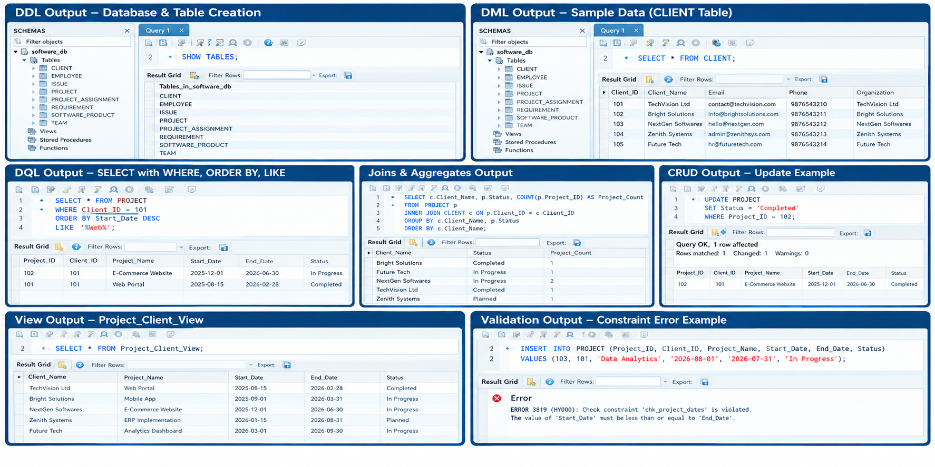
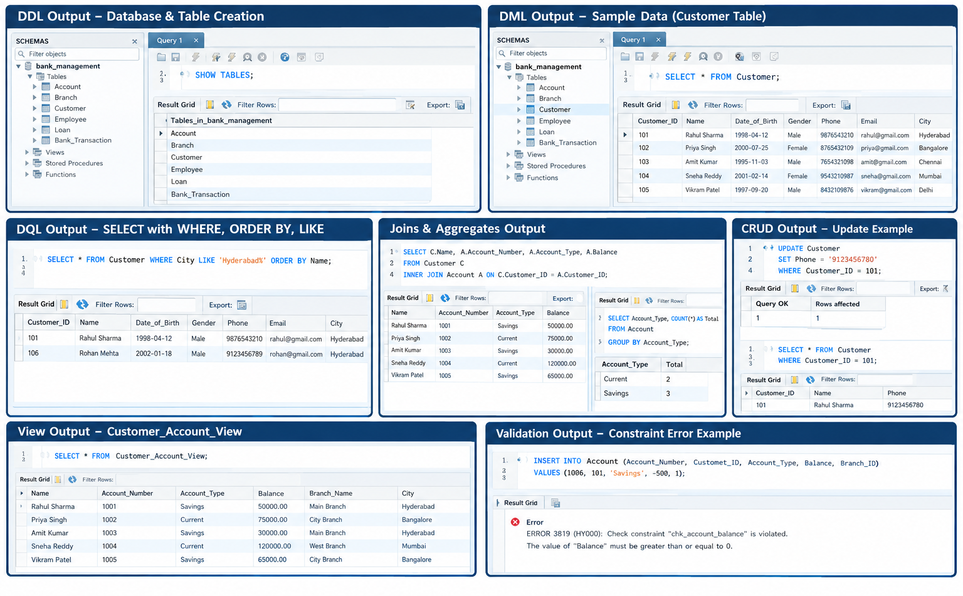
15. SQL Output and Screenshots
16

Slide 17
16. Query Coverage for Demonstration
Category | Demonstration
Basic SELECT | 3–5 queries
Filtering / Sorting | 3–5 queries using WHERE, LIKE, BETWEEN, and ORDER BY
Joins | 5+ meaningful joins / multi-table queries
Aggregation | 5+ COUNT, AVG, MIN, MAX, SUM queries
GROUP BY / HAVING | 2–3 queries
CRUD | At least one example for INSERT, UPDATE, DELETE, and SELECT
Views | 1–2 meaningful views
Validation | At least 2 constraint demonstrations
Our database demonstrates SQL operations from basic retrieval to advanced queries, CRUD, views, and data validation.
17

Slide 18
17. Conclusion
• Successfully designed and implemented the Software Database Management System using MySQL.
• The system manages Client, Project, Employee, Team, Software_Product, Requirement, and Issue data.
• Primary Keys and Foreign Keys maintain relationships between related tables.
• Normalization up to 3NF reduces data redundancy and keeps the database organized.
• Implemented DDL, DML, DQL, CRUD, Joins, Aggregate Functions, GROUP BY, HAVING, and Views.
• Constraints and validation help maintain accurate and consistent project data.
• The system provides a structured foundation for efficient software project management, tracking, and repo
“Our project provides an organized, connected, and reliable database for managing important banking information.”
18

Slide 19
18. Future Enhancements
• Web Application Integration – Connect the database with a web-based software project management application.
• Team Management – Add features for assigning employees to teams and managing team roles.
• Project Tracking – Add detailed project progress, deadlines, status, and resource tracking.
• Issue Management – Provide advanced issue assignment, priority, severity, and status tracking.
• Reports & Analytics – Generate detailed project, employee, requirement, product, and issue reports.
• User Authentication – Add secure login and role-based access for clients, employees, and administrators.
• Backup & Recovery – Implement regular database backup and recovery mechanisms.
• Audit Logging – Track important changes made to project, requirement, employee, and issue records.
“Future enhancements can extend the database into a complete and secure banking management application.”
19

Slide 20
19. Live Database Demonstration – Recommended Order
1. Open the database / schema.
2. Show the six tables and relationships.
3. Show table structures and constraints.
4. Display inserted sample data.
5. Demonstrate DDL, DML, and DQL.
6. Demonstrate CRUD operations.
7. Run joins and aggregate queries.
8. Demonstrate a view.
9. Demonstrate validation / integrity.
10. Explain normalization up to 3NF and answer questions.
20

